Slide 1


Capstone
Project
Presented by
Josephine & Victor

Slide 2
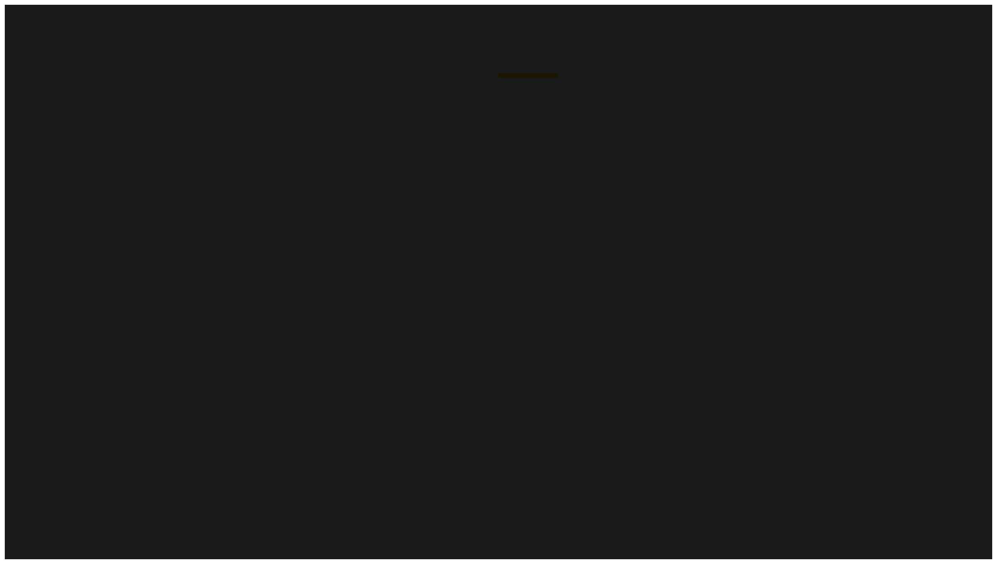
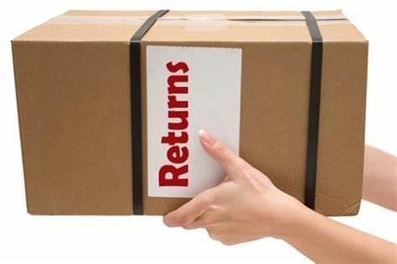

PROBLEM STATEMENT
Velocity railway is currently facing challenges in providing accurate and real-time train departure information to its passengers. The current system provides scheduled departure times but often lacks real-time updates on delays, cancellations or other disruptions. The company wants to create a better pipeline that fetches real time data from a source and saves it on a database for further usages. It also suffers from Data quality issues due to incorrect or incomplete real-time updates ,inconsistent performance in stream processing and validation, single point failures with only one database for storage and lack of real-time monitoring and alert making it difficult to detect pipeline failures or performance bottlenecks.

Slide 3

Expected Outcomes
● The proposed solution should provide accurate real-time departure information by integrating a data source that provides scheduled timetables,real-time train movements.
● Ensure high data quality using a robust validation framework that dynamically adapts to change in data sources and formats.
Be fault-tolerant and highly available,ensuring the system can seamlessly failover to backup systems (local PostgreSQL) if primary system (Azure PostgreSQL) fails.
Enable real-time data processing to support dynamic dashboards,anomaly detection and decision-making
.

Slide 4
Expected Outcomes
● The solution should also:
Orchestrate complex data flows that support real-time data enrichment, processing, validation and storage in a reliable scalable manner.
.

Slide 5
High Level Architecture
Ingestion Layer: Data pulled from API & Real-time data collected through Flink
Data Validation: Great Expectations runs locally to validate ingested data and Validation results are logged.
Data Duplication: Python scripts handle the duplication process, sending data to both Azure PostgreSQL and local PostgreSQL for backup.
Orchestration: Airflow locally orchestrates the full pipeline, managing the ingestion, validation and duplication of data.

Slide 6

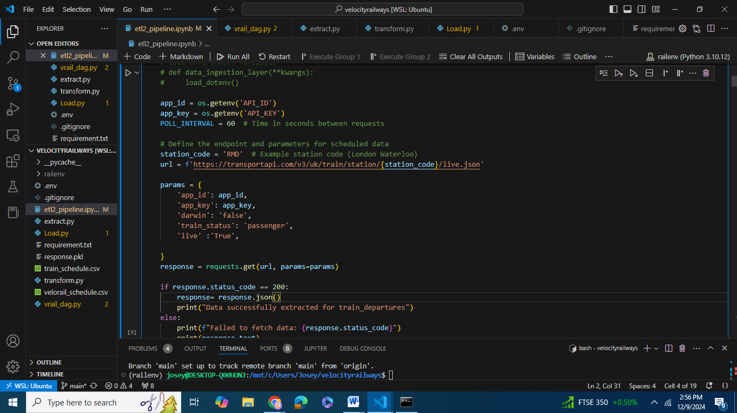
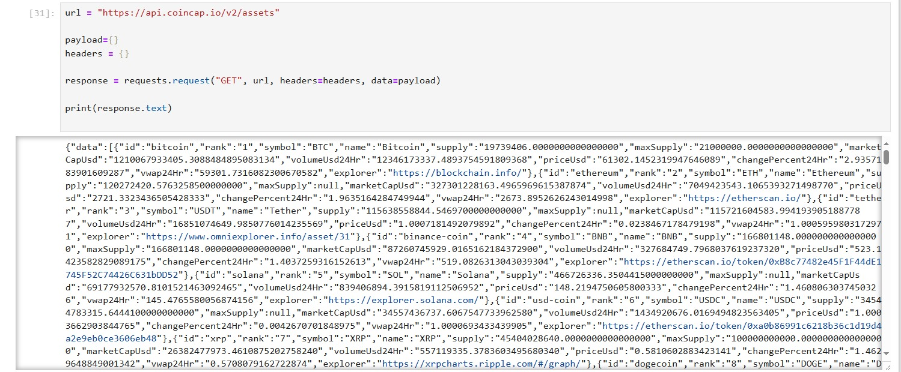
Data Extract Process
.

Slide 7
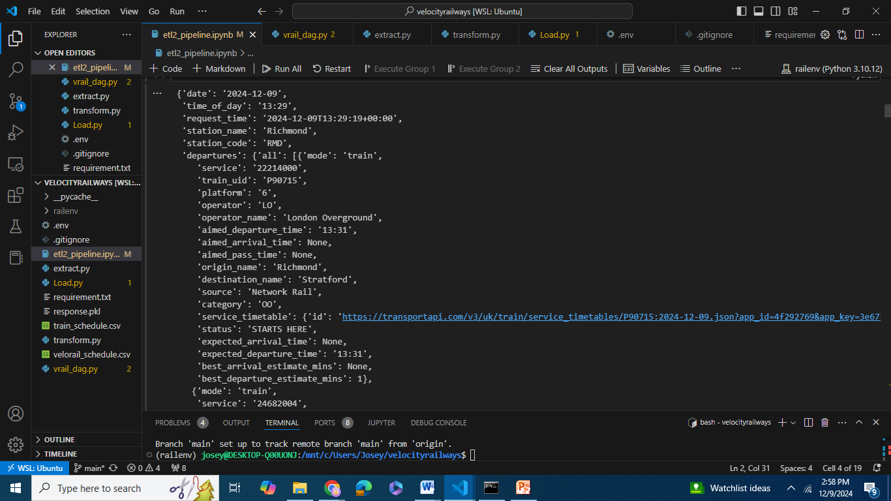
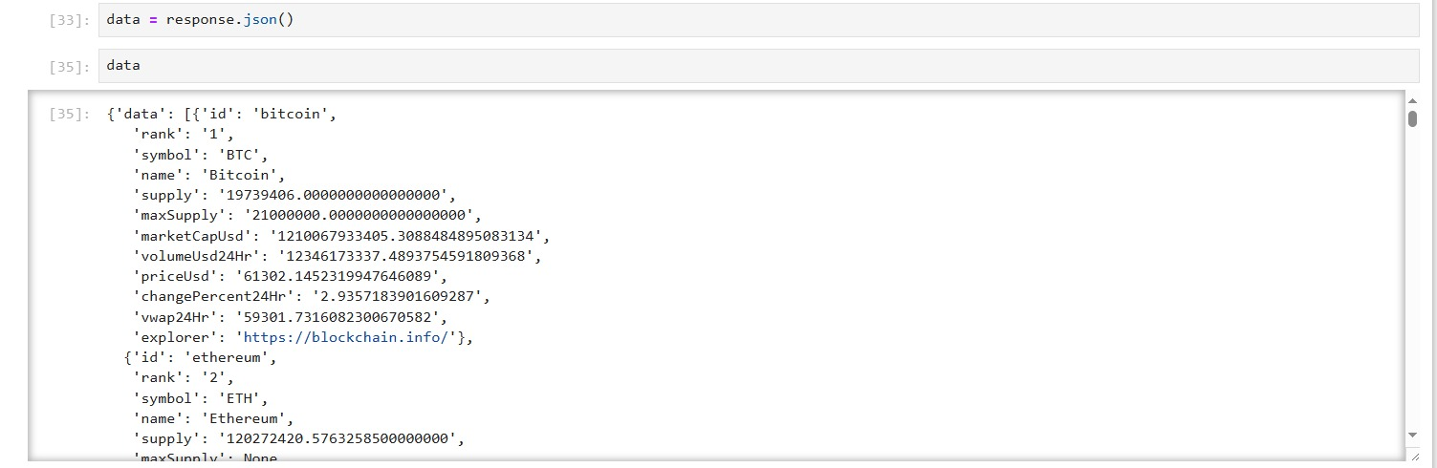
Json Data

Slide 8
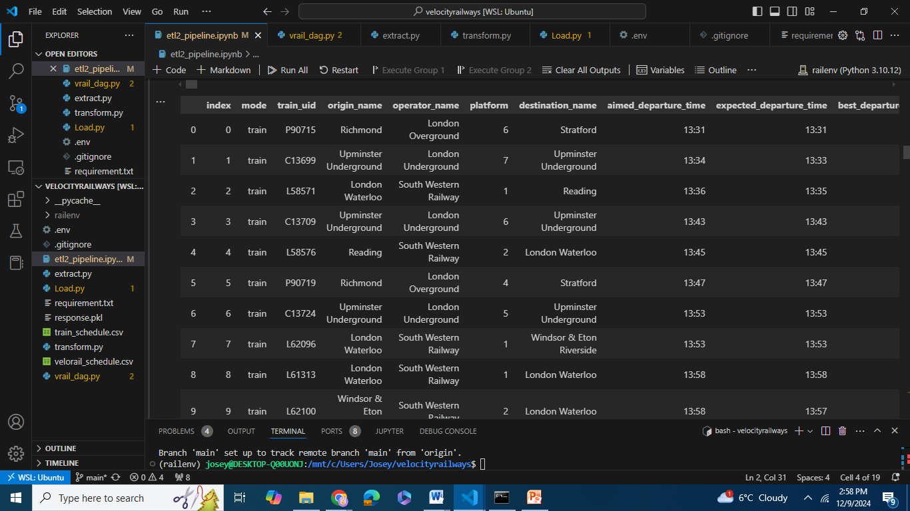
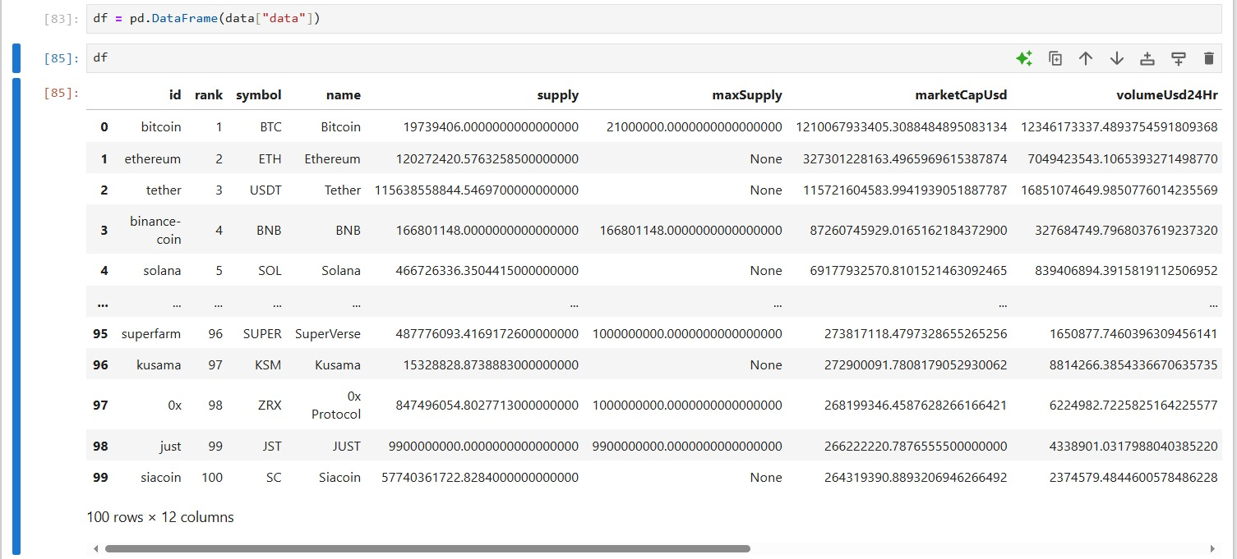
DataFrame

Slide 9
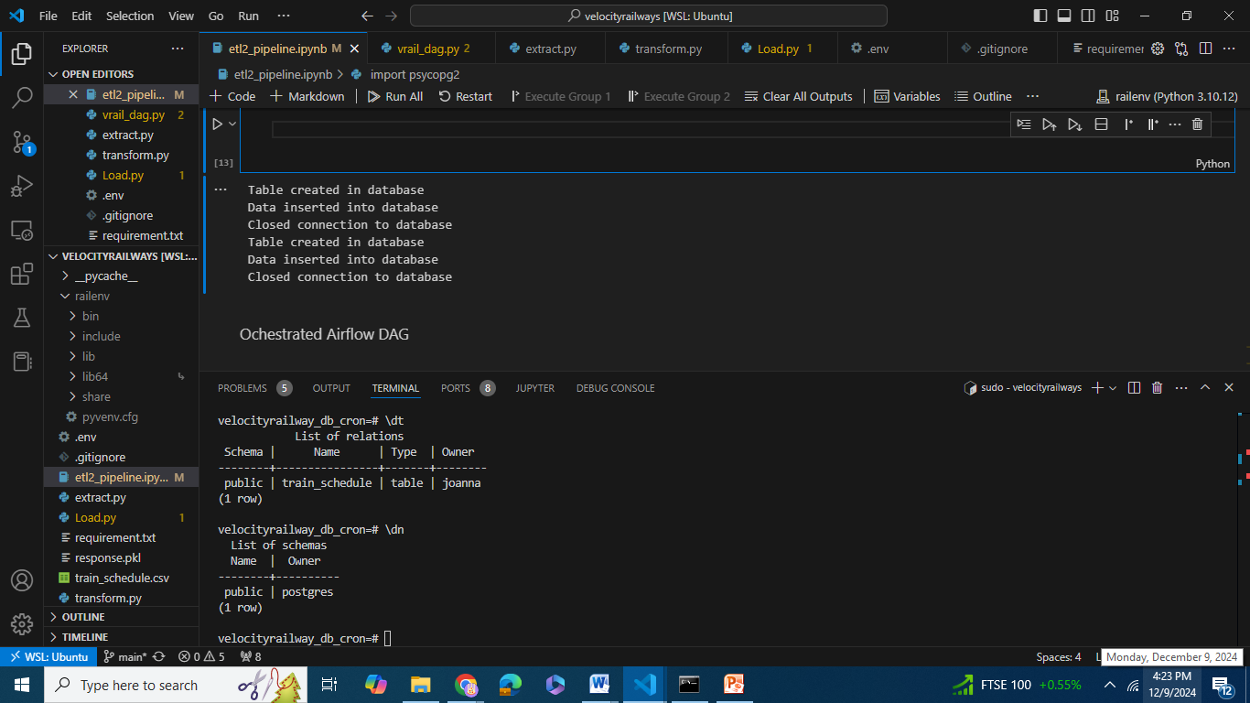
Database Created

Slide 10
Thank You

